Slide 1
Simpl and
Georeferenced data (X, Y, Z, t)
20 December 2024
Ludovic Augé (Alt239)
Dr. Antti Jakobsson* (Location Innovation Hub - National Land Survey of Finland)
Emmanuel Mondon* (AdviceGEO)
* Co-leads of Gaia-X Location Ecosystem

Slide 2
Space Data
Geoinformation Data
Personal data
i.e. GDPR
- Location relative to Earth
- thematic characteristics
Geoinformation Data
(or geospatial or georeferenced)
Photogrammetry
IoT
Geodesy
SatEO
SatNav
SatCom
Data generated
by aerial assets
Data generated
by ground assets
Data generated by space assets

Slide 3
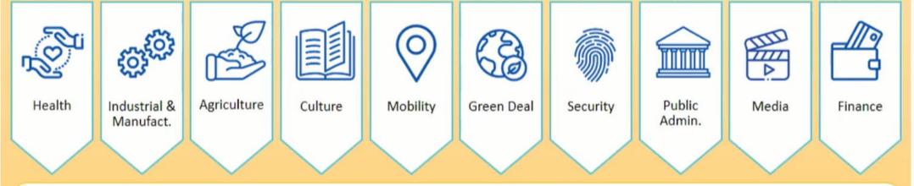

Slide 4
High-Value Datasets (HVD)
https://eurogeographics.org/news/high-value-datasets/
According to the Directive on open data and the re-use of public sector information (PSI),
‘high-value’ means data with the potential to:
generate significant socio-economic or environmental benefits and innovative services;
benefit a high number of users, in particular small to medium sized enterprises (SMEs);
assist in generating revenues; and
be combined with other datasets.
Six thematic categories of high-value datasets are identified in the Directive:
Geospatial
Earth observation and environment
Meteorological
Statistics
Companies and company ownership
Mobility
https://eur-lex.europa.eu/legal-content/EN/TXT/?qid=1561563110433&uri=CELEX:32019L1024

Slide 5
20M€
from
EC DG CNECT
The 4 projects funded by EC DG CNECT related to DEP call Public Sector Open Data for AI and Open Data Platform
(Budget: 20M€ - TOPIC ID: DIGITAL-2022-CLOUD-AI-02-OPEN-AI)
https://ec.europa.eu/info/funding-tenders/opportunities/portal/screen/opportunities/topic-details/digital-2022-cloud-ai-02-open-ai
BeOpen an Open framework for boosting EU High ValueDatasets from Public Sector (Acronym: BeOpen – Project ID: 101100807) https://beopen-dep.eu/about/ .
Project Coordinator: Engineering Ingegneria Informatica S.p.A. https://www.eng.it/en/
Antonio Salvatore Filograna
MAREGRAPH: towards an interoperable MARinE knowledge GRAPH (Acronym: MAREGRAPH – Project ID: 101100771)
Project Coordinator: Flanders Marine Institute (VLIZ – Belgium) https://www.vliz.be/en/
Open Maps for Europe 2 (Acronym: OME2 – Project ID: 101100625)
Project Coordinator: EuroGeographics https://eurogeographics.org/
Victoria Persson, Project Manager – Data Access and Integration
https://eurogeographics.org/news/project-launched-to-prototype-large-scale-high-value-pan-european-datasets/
The Provision of Open Access to Public Meteorological Data and Development of Shared Federated Data Infrastructure for the Development of Information Products and Services (Acronym: RODEO – Project ID: 101100651)
Project Coordinator: Finnish Meteorological Institute (FMI – Finland) https://en.ilmatieteenlaitos.fi/

Slide 6
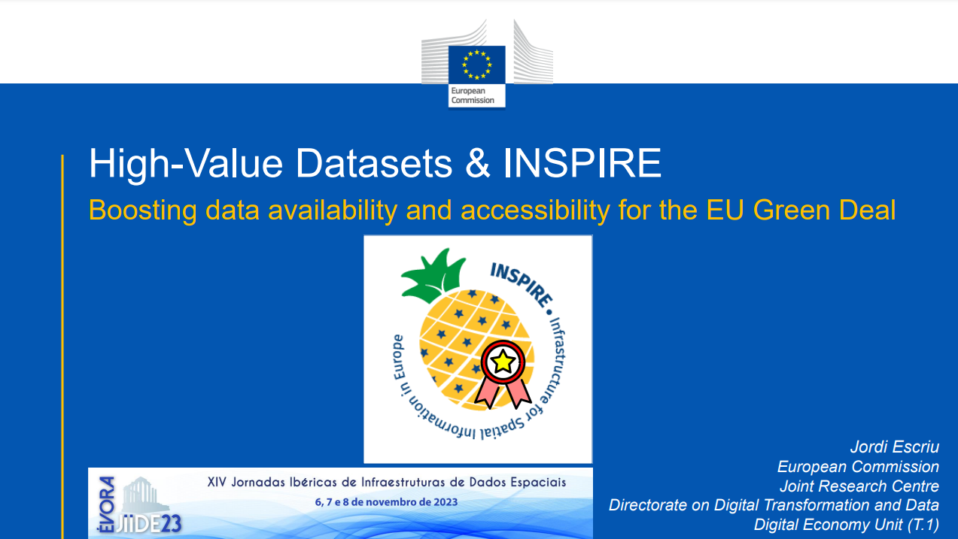
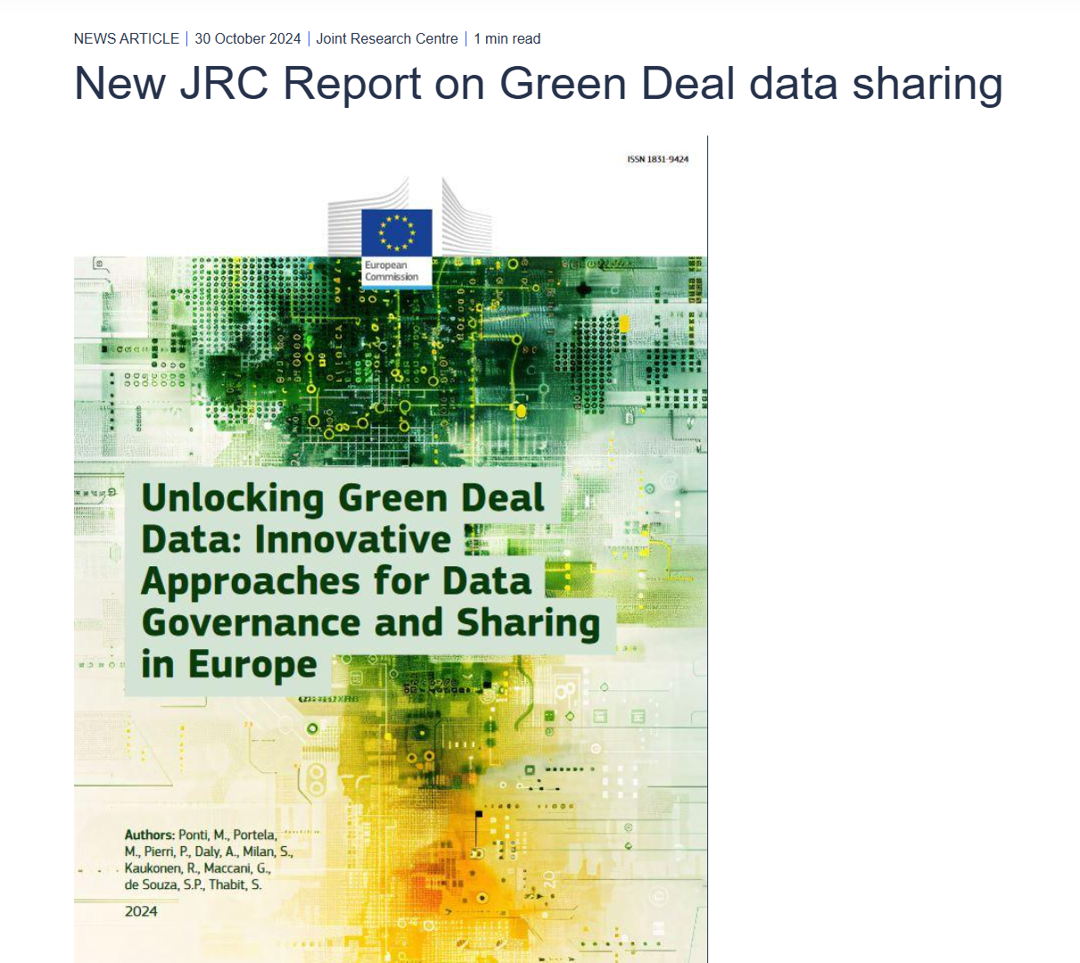
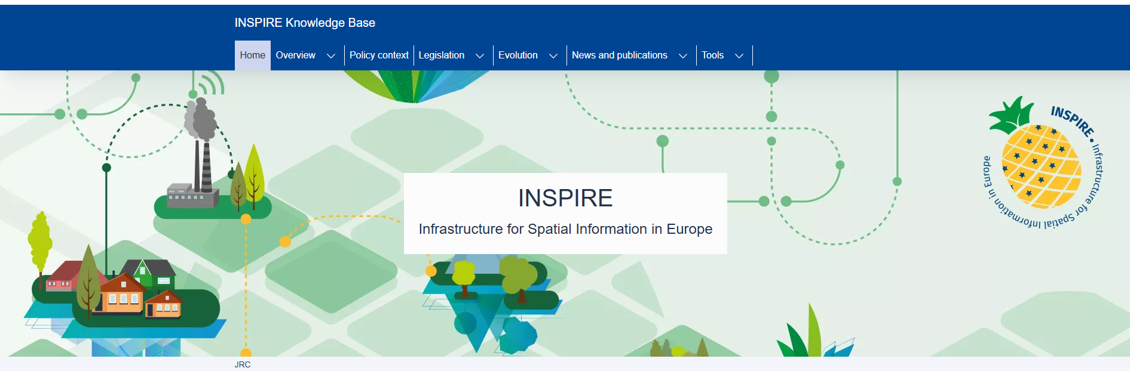
https://eur-lex.europa.eu/EN/legal-content/summary/the-eu-s-infrastructure-for-spatial-information-inspire.html

Slide 7
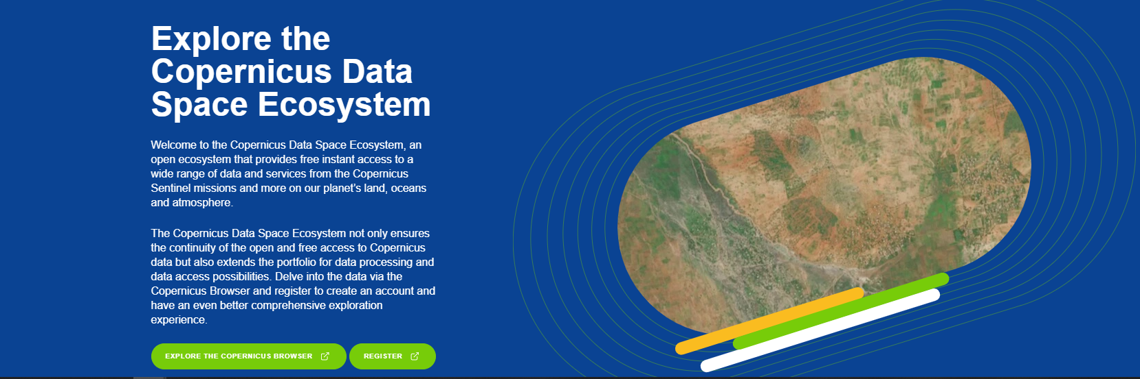
Copernicus Data Space Ecosystem (CDSE)
150M€
from
EC DG DEFIS

Slide 8
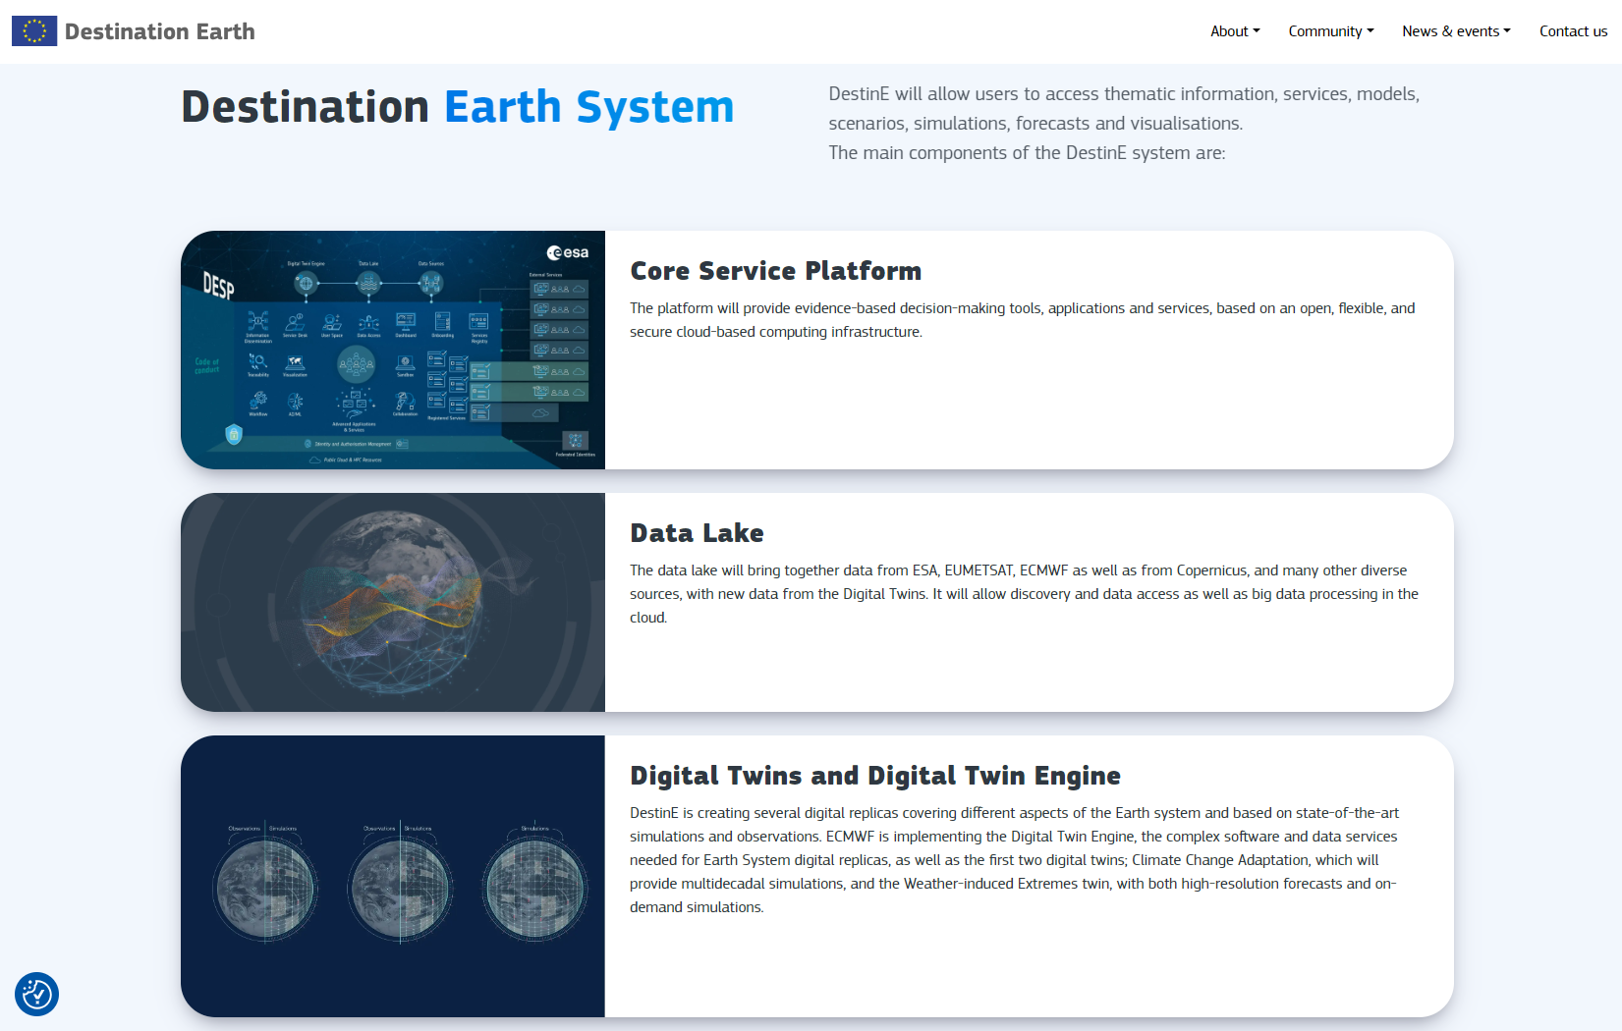
240M€
from
EC DG CNECT

Slide 9
Examples of Common European Data Spaces
Mentionned by Liina Munari (CNECT.C.1)
on 26/01/2022
at the 14th European Space Conference
Destination Earth (DestinE)

Slide 10
Common European Data Spaces

Slide 11
Personal data
i.e. GDPR
- Location relative to Earth
- thematic characteristics
Geoinformation Data
(or geospatial or georeferenced)
Photogrammetry
IoT
Geodesy
SatEO
SatNav
SatCom
Data generated
by aerial assets
Data generated
by ground assets
Data generated by space assets

Slide 12
Common European Data Spaces
How can we bridge the 2 worlds?
Personal data
i.e. GDPR
- Location relative to Earth
- thematic characteristics
Geoinformation Data
(or geospatial or georeferenced)
Photogrammetry
IoT
Geodesy
SatEO
SatNav
SatCom
Data generated
by aerial assets
Data generated
by ground assets
Data generated by space assets

Slide 13


Common European Data Spaces
Personal data
i.e. GDPR
- Location relative to Earth
- thematic characteristics
Geoinformation Data
(or geospatial or georeferenced)
Photogrammetry
IoT
Geodesy
SatEO
SatNav
SatCom
Data generated
by aerial assets
Data generated
by ground assets
Data generated by space assets

Slide 14

Location Data Space
i.e.
a secure and privacy preserving
IT infrastructure
to pool, access, process, use and share
georeferenced data (X, Y, Z, t)
Destination Earth (DestinE)
Public Sector Open Data
for AI and Open Data Platform
DIGITAL-2022-CLOUD-AI-02-OPEN-AI
20M€
Copernicus
Data Space Ecosystem
CSC Data Access Service
(ESA ITT 1-11056)
Personal data
i.e. GDPR
- Location relative to Earth
- thematic characteristics
Geoinformation Data
(or geospatial or georeferenced)
Photogrammetry
IoT
Geodesy
SatEO
SatNav
SatCom
Data generated
by aerial assets
Data generated
by ground assets
Data generated by space assets

Slide 15
Location
Data Space
Ecosystem
to
pool, access, process, use and share
georeferenced data (X, Y, Z, t)
Destination Earth (DestinE)
Public Sector Open Data
for AI and Open Data Platform
DIGITAL-2022-CLOUD-AI-02-OPEN-AI
20M€
Copernicus
Data Space Ecosystem
CSC Data Access Service
(ESA ITT 1-11056)
Personal data
i.e. GDPR
- Location relative to Earth
- thematic characteristics
Geoinformation Data
(or geospatial or georeferenced)
Photogrammetry
IoT
Geodesy
SatEO
SatNav
SatCom
Data generated
by aerial assets
Data generated
by ground assets
Data generated by space assets

Slide 16
Location
Data Space
Ecosystem
to
pool, access, process, use and share
georeferenced data (X, Y, Z, t)
Destination Earth (DestinE)
Public Sector Open Data
for AI and Open Data Platform
DIGITAL-2022-CLOUD-AI-02-OPEN-AI
20M€
Copernicus
Data Space Ecosystem
CSC Data Access Service
(ESA ITT 1-11056)
Personal data
i.e. GDPR
- Location relative to Earth
- thematic characteristics
Geoinformation Data
(or geospatial or georeferenced)
Photogrammetry
IoT
Geodesy
SatEO
SatNav
SatCom
Data generated
by aerial assets
Data generated
by ground assets
Data generated by space assets

Slide 17
Connector / Agent bringing interoperability across Data Spaces :
Simpl, FIWARE NGSI API, Eclipse Dataspace Connector, etc…
Location
Data Space
Ecosystem
to
pool, access, process, use and share
georeferenced data (X, Y, Z, t)
Destination Earth (DestinE)
Public Sector Open Data
for AI and Open Data Platform
DIGITAL-2022-CLOUD-AI-02-OPEN-AI
20M€
Copernicus
Data Space Ecosystem
CSC Data Access Service
(ESA ITT 1-11056)
Personal data
i.e. GDPR
- Location relative to Earth
- thematic characteristics
Geoinformation Data
(or geospatial or georeferenced)
Photogrammetry
IoT
Geodesy
SatEO
SatNav
SatCom
Data generated
by aerial assets
Data generated
by ground assets
Data generated by space assets

Slide 18
Common European Data Spaces
Connector / Agent bringing interoperability across Data Spaces :
Simpl, FIWARE NGSI API, Eclipse Dataspace Connector, etc…
Location
Component
Personal data
i.e. GDPR
- Location relative to Earth
- thematic characteristics
Geoinformation Data
(or geospatial or georeferenced)
Photogrammetry
IoT
Geodesy
SatEO
SatNav
SatCom
Data generated
by aerial assets
Data generated
by ground assets
Data generated by space assets

